Slide 1
Data Visualisation: Principles and practical applications in Excel
Dr Jon Minton
Applied Quantitative Methods Network (AQMeN)
University of Glasgow
Jonathan.minton@glasgow.ac.uk

Slide 2
Course Structure
Morning
Principles and concepts of data visualisation
Data management
Longer-term suggestions
Afternoon
Some data management & visualisation recipes and ‘hacks’
Group exercises
Presentations

Slide 3
Statistical Inference and Data Visualisation
Complementary Roles
Statistical Inference lowers the hurdle
Data Visualisation lets people jump higher

Slide 4
Why Excel?
Employability: Not just a social science skill, but an office skill.
Compatibility: Can work with data in a wide range of formats; very widely used.
Flexibility: Excel can be used to do much more than it was designed to do! (Not always a good thing…)
Intuitiveness: cells update and respond to instructions instantly.
Graphical: Good options for formatting data in visually pleasing ways; good graphics capabilities.
Formula-based: operations can be automated; a friendly way to start learning to code.

Slide 5
A Question
What is a good data visualisation?

Slide 6
The Answer
It depends.
Good data visualisations don’t have to be:
Quick
Simple
Easy to understand
Original
Eye-catching
What matters is how well matched the visualisation is with the audience

Slide 7
Two types of audience
Internal/Specialist
Data Visualisation as Exploratory Data Analysis
A recursive, two-way process
External/Generalist
‘Narrative’ Data Analysis
A one-way process

Slide 8
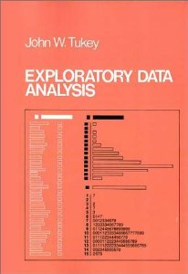
John Tukey
Exploratory Data Analysis
Crudely:
A series of (mainly visual) methods for trying to be less dependent on summary statistics and the assumptions used to construct them.

Slide 9
Why use visualisation for Exploratory Data Analysis?
I |  | II |  | III |  | IV
x | y | x | y | x | y | x | y
10.0 | 8.04 | 10.0 | 9.14 | 10.0 | 7.46 | 8.0 | 6.58
8.0 | 6.95 | 8.0 | 8.14 | 8.0 | 6.77 | 8.0 | 5.76
13.0 | 7.58 | 13.0 | 8.74 | 13.0 | 12.74 | 8.0 | 7.71
9.0 | 8.81 | 9.0 | 8.77 | 9.0 | 7.11 | 8.0 | 8.84
11.0 | 8.33 | 11.0 | 9.26 | 11.0 | 7.81 | 8.0 | 8.47
14.0 | 9.96 | 14.0 | 8.10 | 14.0 | 8.84 | 8.0 | 7.04
6.0 | 7.24 | 6.0 | 6.13 | 6.0 | 6.08 | 8.0 | 5.25
4.0 | 4.26 | 4.0 | 3.10 | 4.0 | 5.39 | 19.0 | 12.50
12.0 | 10.84 | 12.0 | 9.13 | 12.0 | 8.15 | 8.0 | 5.56
7.0 | 4.82 | 7.0 | 7.26 | 7.0 | 6.42 | 8.0 | 7.91
5.0 | 5.68 | 5.0 | 4.74 | 5.0 | 5.73 | 8.0 | 6.89
The Anscombe Quartet (1973)

Slide 10
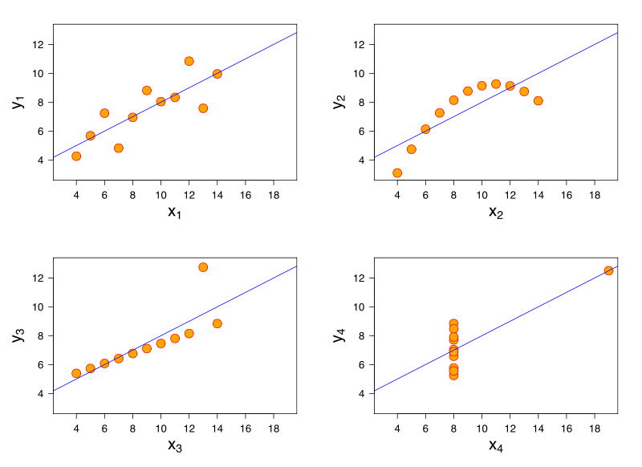
Why use visualisation for Exploratory Data Analysis?
I |  | II |  | III |  | IV
x | y | x | y | x | y | x | y
10.0 | 8.04 | 10.0 | 9.14 | 10.0 | 7.46 | 8.0 | 6.58
8.0 | 6.95 | 8.0 | 8.14 | 8.0 | 6.77 | 8.0 | 5.76
13.0 | 7.58 | 13.0 | 8.74 | 13.0 | 12.74 | 8.0 | 7.71
9.0 | 8.81 | 9.0 | 8.77 | 9.0 | 7.11 | 8.0 | 8.84
11.0 | 8.33 | 11.0 | 9.26 | 11.0 | 7.81 | 8.0 | 8.47
14.0 | 9.96 | 14.0 | 8.10 | 14.0 | 8.84 | 8.0 | 7.04
6.0 | 7.24 | 6.0 | 6.13 | 6.0 | 6.08 | 8.0 | 5.25
4.0 | 4.26 | 4.0 | 3.10 | 4.0 | 5.39 | 19.0 | 12.50
12.0 | 10.84 | 12.0 | 9.13 | 12.0 | 8.15 | 8.0 | 5.56
7.0 | 4.82 | 7.0 | 7.26 | 7.0 | 6.42 | 8.0 | 7.91
5.0 | 5.68 | 5.0 | 4.74 | 5.0 | 5.73 | 8.0 | 6.89
The Anscombe Quartet (1973)

Slide 11

Edward Tufte
Born 1942
Statistician
Sculptor
Advisor to Obama
Contributions to data visualisation
Conceptual Tools
Data Ink Ratios
Lie Factors
Chart Junk
Visualisations
Small multiples
Sparklines

Slide 12
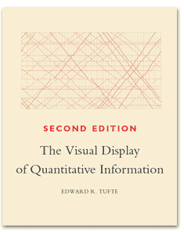

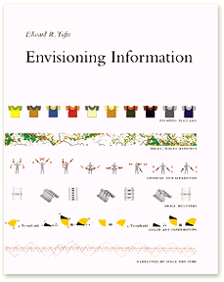

Books by Edward Tufte

Slide 13

Steven Few
Data visualisation consultant
www.perceptualedge.com
Tufte-inspired unfussy informative data visualisation
Practical, Excel-focused books
Show Me The Numbers
Information Dashboard Design
Now You See It

Slide 14
Leland Wilkinson and Hadley Wickham
Wilkinson
The Grammar of Graphics 2000 [2005]
A language and set of terms for thinking more clearly about the construction of data visualisations
Hadley Wickham
ggplot2 2009 onwards
A very popular implementation of gg principles

Slide 15
The Three Hats
Three different skill sets
Three different mind sets
What are they?

Slide 16
The Three Hats
Scientist
Artist
Engineer

Slide 17
The Engineer must have broad shoulders
S
A
E

Slide 18
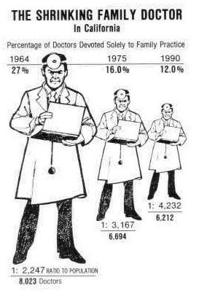
Are your visualisations... lying?
What’s the ‘lie factor’?
- Edward Tufte
“
The representation of numbers, as physically measured on the surface of the graphic itself, should be directly proportional to the quantities represented
”
Tufte 1991
S
A
E

Slide 19
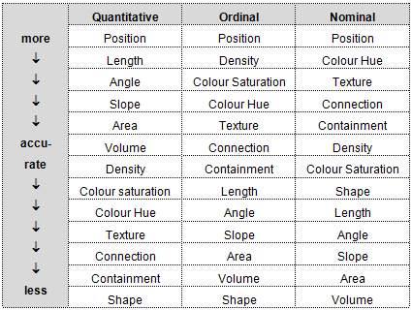
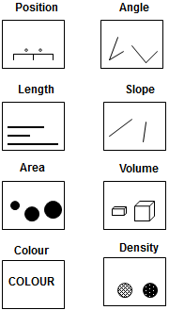
Are your visualisations... Accurately interpretable?
Cleveland W & McGill R (1985), ‘Graphical Perception and Graphical Methods for Analysing Scientific Data’, Science (229) 4716: 828-833
S
A
E

Slide 20
Are your visualisations... Sensible?
S
A
E

Slide 21
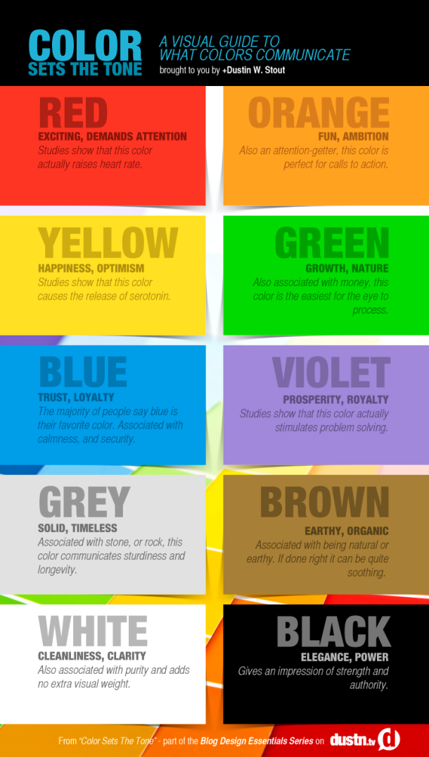
Visualisations
and colour
S
A
E

Slide 22
Why is Facebook blue?
Colour and
accessibility
S
A
E

Slide 23
Colour and
appropriateness
to variables
S
A
E

Slide 24
Circles and Squares: A faultline?
S
A
E

Slide 25
Data Visualisation is…
…the development and consistent application of rules for mapping between data and graphics.
(equivalently) ... using quantitative (statistical) data as instructions for the production of images.
A necessary condition for something to be a data visualisation; but not a sufficient condition for something to be a good data visualisation

Slide 26
Data Visualisation is...
... using quantitative (statistical) data as instructions for the production of images.
QUESTIONS
What data?
How are the data converted into instructions?
Who/what is being instructed?
What image?

Slide 27
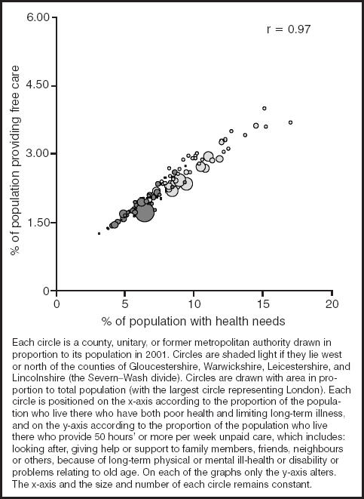
As an example...
How are data being converted into instructions here?
How many dimensions does this visualisation have?

Slide 28
As an example...
How are data being converted into instructions here?
How many dimensions does this visualisation have?
Shaw M & Dorling D (2004) “Who cares in England and Wales? The Positive Care Law: cross-sectional study” British Journal of General Practice, 54 (509): 899-903

Slide 29
Data Visualisation as Box Wiring
Data Variable |  | Graphical Aesthetic
% of population providing free care |  | Position along horizontal axis
% of population with health needs |  | Position along vertical axis
Areal unit population |  | Size of bubble
Geographical location (North or south) |  | Colour of bubble

Slide 30
Data Visualisation as Box Wiring
Data Variable |  | Graphical Aesthetic
% of population providing free care |  | Position along horizontal axis
% of population with health needs |  | Position along vertical axis
Areal unit population |  | Size of bubble
Geographical location (North or south) |  | Colour of bubble

Slide 31
Double-Encoding for Emphasis
Data Variable |  | Graphical Aesthetic
% of population providing free care |  | Position along horizontal axis
% of population with health needs |  | Position along vertical axis
Areal unit population |  | Size of bubble
Geographical location (North or south) |  | Colour of bubble

Slide 32
Excel Graphics
Graphical Theory: Imagine the graphic is made up of layers; each doing functionally different things:
The Guide Layer: Defines and details the canvas
The Data Layer: Where and how the data are mapped onto the canvas
The Annotation Layer: Additional design features added afterwards
The following shows how the same data can be graphed in lots of different ways

Slide 33
The Guide Layer: Excel Default

Slide 34
The Guide Layer: Major Gridlines

Slide 35
The Guide Layer: Major and Minor Gridlines

Slide 36
The Guide Layer: Major and Minor Gridlines

Slide 37
The Guide Layer: Gridlines Removed

Slide 38
The Guide Layer: Unit interval tickmarks

Slide 39
The Guide Layer: 1:1 Ratio

Slide 40
The Support Layer: Excel Default

Slide 41
The Geom: Points

Slide 42
The Geom: Lines

Slide 43
The Geom: Bars

Slide 44
The Geom: Area

Slide 45
The Annotation Layer

Slide 46
The Annotation Layer

Slide 47
The Annotation Layer
Fig XXX: A plot of y against x. Y represents... X represents... Note the ...Sed consequat dolor a purus molestie aliquet. Maecenas dignissim, urna nec condimentum egestas, lectus tellus interdum enim, vel viverra felis arcu eget odio. Nam placerat faucibus sem ut ornare. Etiam et nulla quam. Suspendisse dolor diam, feugiat sit amet erat sed, accumsan hendrerit erat. Aenean dictum vulputate eros, sed adipiscing erat pulvinar a. Fusce mattis convallis metus, quis te.
Data source:...

Slide 48
The Annotation Layer
Sed at dui at urna ullamcorper cursus.
Aenean suscipit
Aenean suscipit
Aenean suscipit semper tortor eu suscipit. Vestibulum ante ipsum primis in faucibus orci luctus et ultrices posuere cubilia Curae
Data source:...

Slide 49
Tidy Data
Very important
Useful things to know
Importing from plain text
Importing from web tables
Exporting
Cleaning
Formatting
Rearranging Data
S
A
E

Slide 50
Key ideas
Pipes and porcelin: Plumbing and architecture
Research as plumbing
Information for humans, data for computers
Tidy data concepts and ideas
The target structure
‘Messy data’ examples
Tools for data tidying
Further reading

Slide 51

Pipes and porcelin
What are your needs as a user?
What needs to happen to meet your needs?
What can go wrong? How are problems fixed?

Slide 52
Academic Research is architecture AND plumbing
 | Report Writing | Qualitative Research | Quantitative Research
Architecture
Plumbing

Slide 53
Information and data
People want information
Computers need data

Slide 54
Example: Car and Van ownership in Scotland
Why might we be interested in car and van ownership in Scotland, and how it has changed between 2001 and 2011?
What are the differences between each of these files?
2001 census
Initial file
Modified
2011 census
Initial file
Modified
Combined

Slide 55
Data tidying for easier control
Tap controls
Up: more; down: less
Left: warmer; right: colder
An important aim of data management is to get the data into a form where you can control what you get more easily
How was this achieved with the previous example?

Slide 56
A target tidy data form
Datazone | Local authority | year | total | none
‘Where’ variables |  |  | ‘What’ variables
What variables: Report measured values
Where variables: Describes the characteristics of what was measured

Slide 57
Derived variables: ‘window variables’
Datazone | Local authority | year | total | none | Proportion without a car or van | Proportion with a car or van
‘Where’ variables |  |  | ‘What’ variables
Window variables make the dataset wider (More columns)
But the data still has as many rows
Example using Excel:

Slide 58
Derived variables: ‘summary variables’
Local authority | year | Total by LA and year | None by LA and year
‘Where’ variables |  | ‘What’ variables
Summary variables reduce the size (number of rows) of the data
What is the example above
Example using Excel

Slide 59
Further viewing and reading
Hadley Wickham, ‘Tidy Data’
http://www.jstatsoft.org/v59/i10/paper
Focus on the examples, not the methods/case study described later.
Hadley Wickham’s Presentation
https://vimeo.com/33727555
Again, focus on the examples

Slide 60
Computer-friendly data formatting
Computers think data are rectangular arrays of cells:
Rows are observations
Columns are variables
Suggestion:
Make use of the tab feature in Excel
First tab: information about data sources
Next tabs: Analyses of the data
Last tabs: the data rectangles themselves
Label the tabs clearly

Slide 61
Person-friendly data formatting
People respond to visual cues
Distance between cells
Font size and formatting
Colour and shading
Arrangement of tables
It’s usually possible to make data easier for people to read without making it harder for computers to read. For example, there’s usually no need to break the rectangle.

Slide 62
Excel Tips: Kludging
Tidying:
concatenate, split, remove white space, delete empty rows and columns
Window functions:
adding new columns with formula (sum, average, if statements)
Merging:
Vlookup: LEARN THIS!
Summary functions
pivot-tables
Exploratory data analysis
Pivot-tables and pivot-charts
Pasting
Links vs values

Slide 63
Excel tips: Publication visualisation
Dialogue boxes
Select data
Change chart type
Guide layer
Adjust guidelines, legends, tick values and spacing
Statistics
Trendlines and summary stats
Aesthetics
Colours, linetypes, etc
Templates
Save bespoke designs to consistently apply

Slide 64
Simple formulae, tips and tricks using Excel
Formulae:
Specifying formulae: begin with =
Formulae contains arguments
Arguments are either single cells, or groups of cells
The formula is evaluated, producing its value.
Formulae can contain other formulae
Formulae can be copied from cell to cell:
input cells references (arguments) are relative rather than absolute
Cells can be made absolute using $, the anchor symbol (Also F4)

Slide 65
Simple formulae, tips and tricks using Excel
Filtering and sorting
With data in a rectangular format, select the top left cell, then CTRL+SHIFT+RIGHT, then CTRL+SHIFT+DOWN: You have now selected all the data
Select ‘Home’ -> ‘Sort and Filter’ -> Filter
Filtering is very powerful, but can be limited by the format of the data
The ‘transpose’ option (Copy -> Paste special -> Transpose), can be useful for rearranging data. But Excel is not great at reshaping data

Slide 66
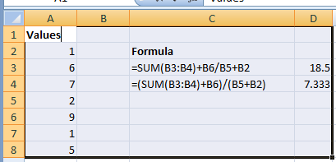
Simple formulae, tips and tricks using Excel
BODMAS
Brackets: ( and )
Operations: e.g. pow(), log(), sum(), average()
Division and Multiplication: / or *
Addition and Subtraction: + or –
If in doubt:
Use brackets
Formulas -> ‘Evaluate formula’

Slide 67
Excel Graphics
Can be flexible, precise, and elegant.
Many quantitative researchers think the graphical aesthetics are poor. But they can be changed.
A good guide:
Few, S (2012), Show me the numbers
Ultimately, graphics are made with formulae too. But it is best to use with dialogue boxes.

Slide 68
Excel Graphics
My usual approach:
Select the complete rectangle of data
Select ‘Insert’ -> ‘Chart’ -> then a (roughly) appropriate chart type
With the chart selected, click on ‘Design’ -> ‘Select Data’, in order to fine tune the data

Slide 69
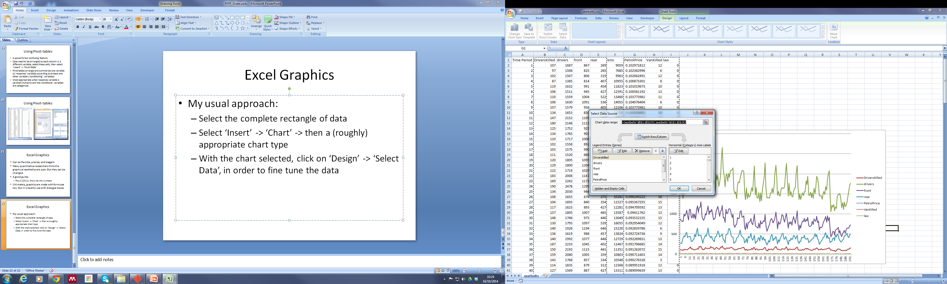
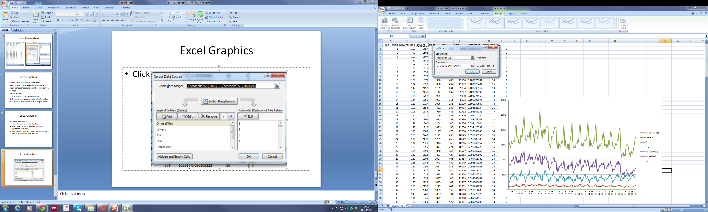
Excel Graphics

Slide 70
Excel Graphics
Possibilities
Mixed chart types (e.g. bars and lines)
Templates
Bubble plots
Printer & colour-blind friendly layouts
Labelling & annotating

Slide 71
Excel Graphics
The importance of the right graphic for the right audience.
The same data can usually be represented in lots of different ways; each graphical design choice will tell something different about the data to the audience.

Slide 72
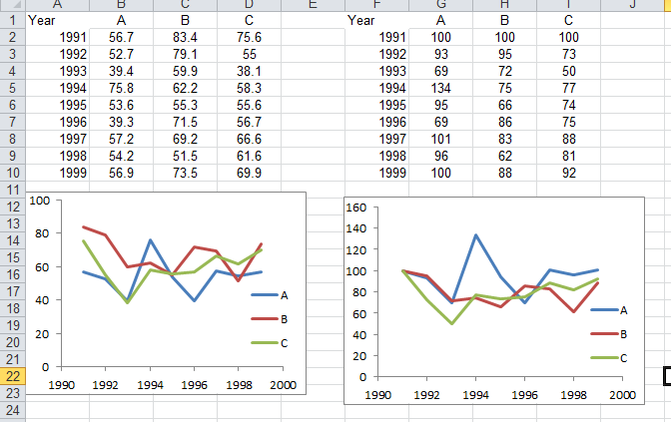
Simple formulae, tips and tricks using excel
Indexing:
It can be useful, when looking at trends over time, to put all time series to a common scale
To do this, use anchoring and cell formatting

Slide 73
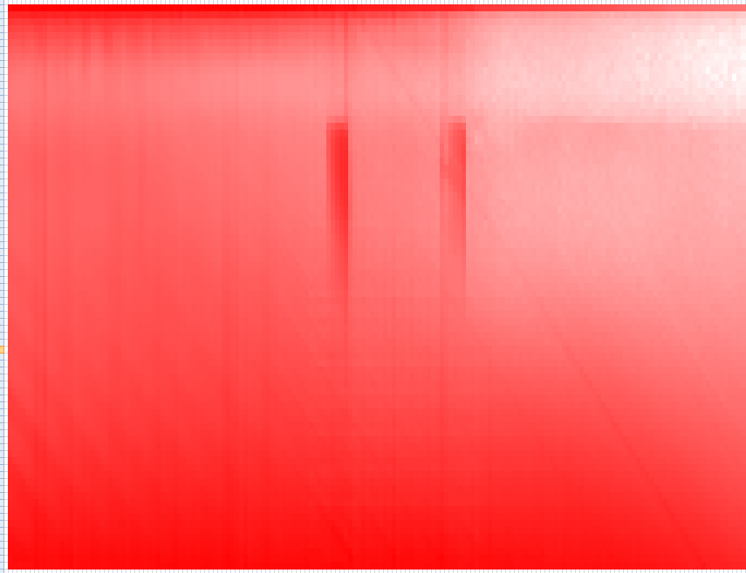
Simple formulae, tips and tricks using excel
Conditional formatting
It is possible to apply conditional formatting to cells, which can make it easier to identify patterns in many numbers, or at least look interesting

Slide 74
Excel Tips: Pivot-tables and pivot-charts
Pivot-tables are good for
re-arranging data
re-analyses and exploration
Pivot-charts
Adjunct to pivot-tables
Effective for exploratory data analysis

Slide 75
Using Pivot-tables
A powerful but confusing feature
Data need to be arranged so each column is a different variable; select these cells, then select ‘Insert’ -> ‘Pivot Table’
Pivot tables arrange and summarise one variable (a ‘response’ variable) according to at least one other variable (‘conditioning’ variables)
Most appropriate when response variable is cardinal (numeric) and the conditional variables are categorical.

Slide 76


Using Pivot-tables

Slide 77
Afternoon session
An afternoon of three parts
Part one: Some practical tips with data management (All delegates)
Part two: Split into 3-4 groups
Decide on the data to use
Decide on the type of visualisation to produce
Part three: Presentation of visualisation

Slide 78
Types of data
Census Data
Two years
Datazone and local authority
SNS Data
Housing Data
Time series
Pre-tidied

Slide 79
Conclusion
Excel has a lot of potential, but also takes a lot of time to use well.
It is good for:
Helping to explore fairly simple data
Learning and applying basic programming principles
Data cleaning and exploration
Working with lots of data formats
Producing publication ready graphs and tables
Employability outside of academia
It is less good for:
Doing complex statistics
Rearranging data (e.g. Wide to long and back again)
Showing the research process in a linear and sequential way (‘audit trail’
Automating analyses

Slide 80
Data Visualisation: A Bar Bell Strategy
The two extremes:
Excel
R
A third option:
Tableau

Slide 81
Any final thoughts?
Thanks for listening!
Jonathan.minton@glasgow.ac.uk

Slide 82
Additional material

Slide 83
Accessing data from different sources
Registration
Restricted access and special licenses
Data queries and previewing
Manuals and help files
Saving downloads sensibly
Know your browser’s download folder
Many files are automatically given the same name

Slide 84
Differences between data formats
Ultimately, all computer data is a stream of 0s and 1s
Data scientists distinguish between two types of computer file:
Text files: human readable
Binary files: instructions for a computer; has to be interpreted by software
You can usually tell which is which through the file extension
.tab; .txt; .csv
.por; .spss; .sav; .xls; .xlsx
Excel can read and write data in text files. These data lose formula and formatting, but are compatible between software and future proofed

Slide 85
Differences between data formats
Text files are streams, but datasets are rectangles.
How does the computer turn the streams into rectangles?

Slide 86

Differences between data formats
It looks for cues: data about how to order the data.
Two main types:
Column delimiters
Row delimiters
These are easier to see in text files, but some times the delimiters are invisible
Example:

Slide 87
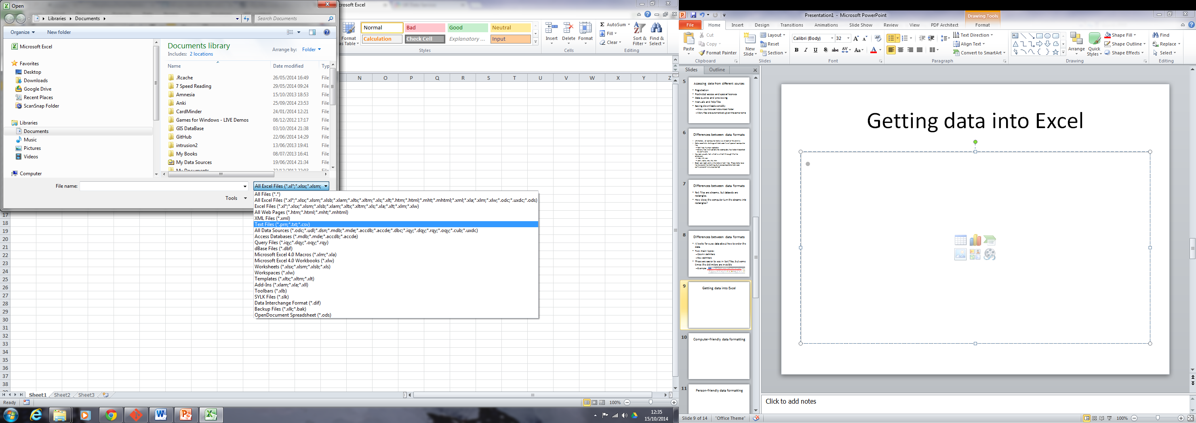
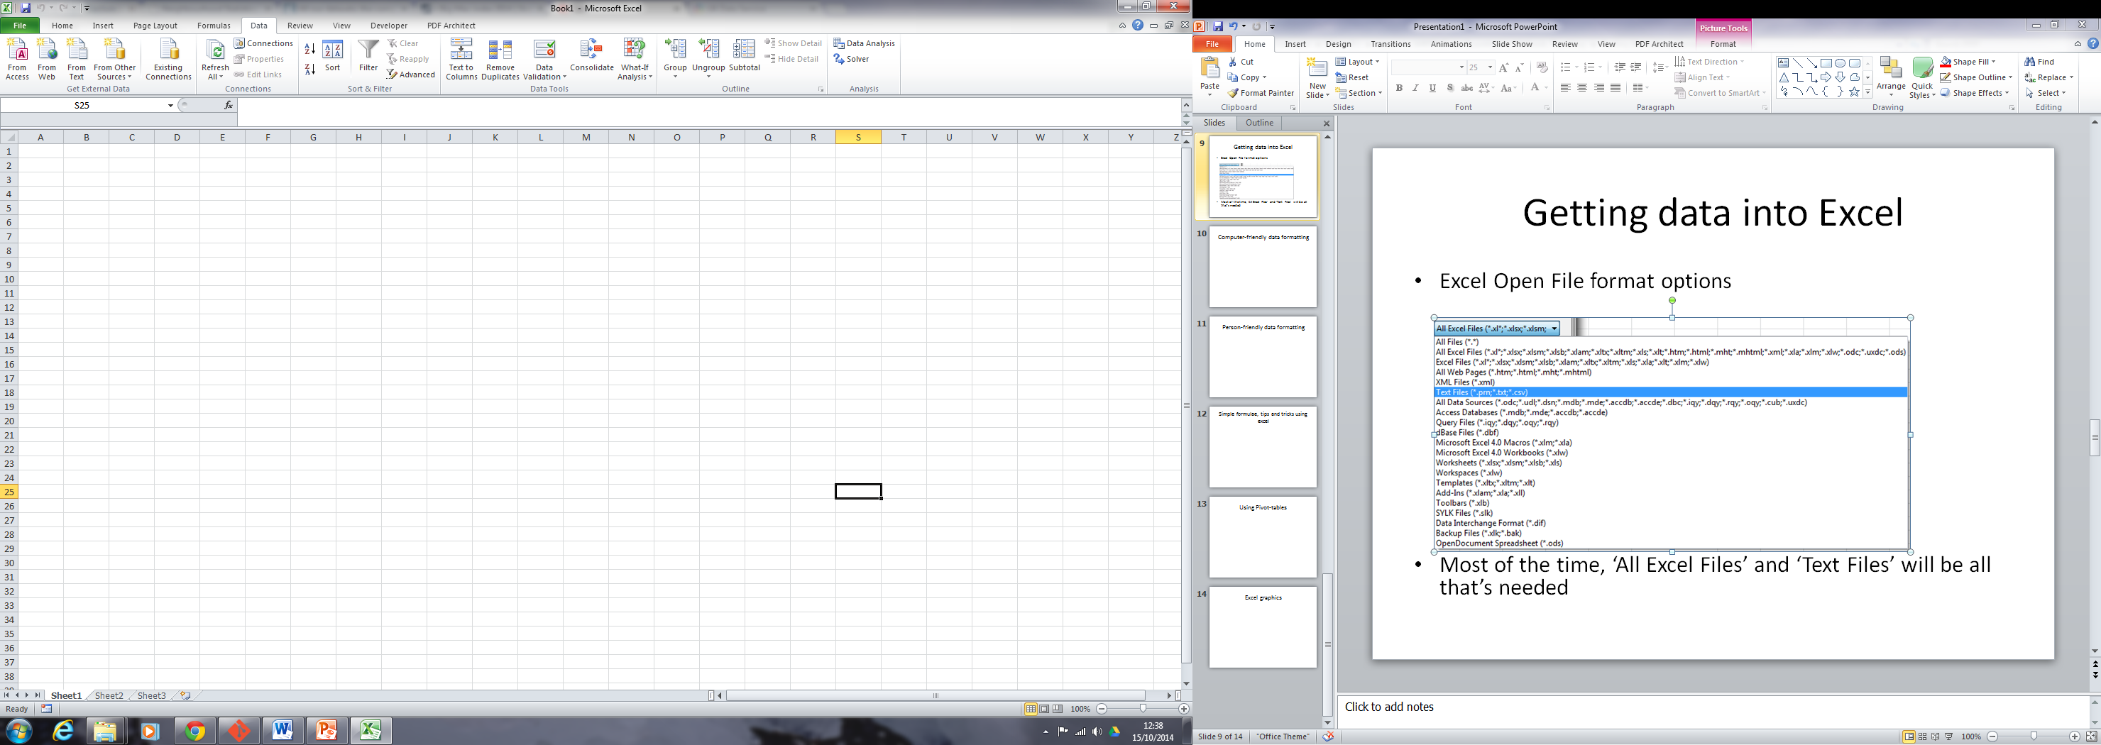
Getting data into Excel
Excel Open File format options
Most of the time, ‘All Excel Files’ and ‘Text Files’ will be all that’s needed

Slide 88
Getting data into Excel
There’s a difference between opening and importing; and saving and exporting.
Opening (say) a .csv file:
Presents the file contents in Excel, but does not create a new Excel file
The file can be changed from Excel, but only changes the file format can handle will be retained
Importing the same file into an Excel workbook:
The contents of the (say) .csv file will be pasted into cells in the workbook. The text file itself will not be changed, but the workbook will be.
The workbook can be used to store the contents of the text file, and also additional information like formatting
Saving/Exporting: As above, but in reverse.

Slide 89
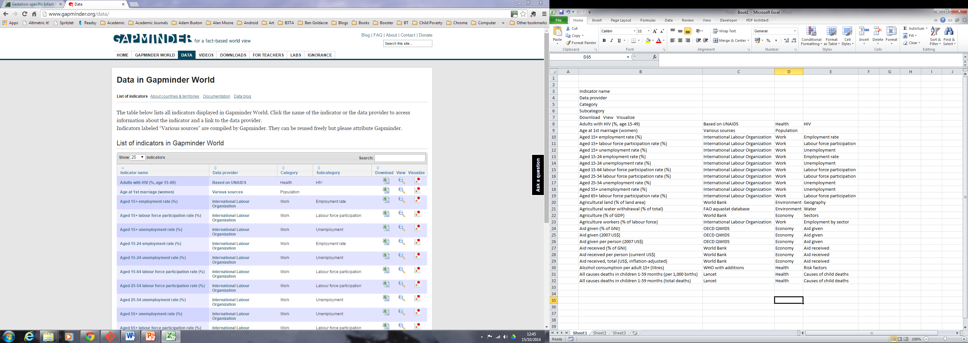
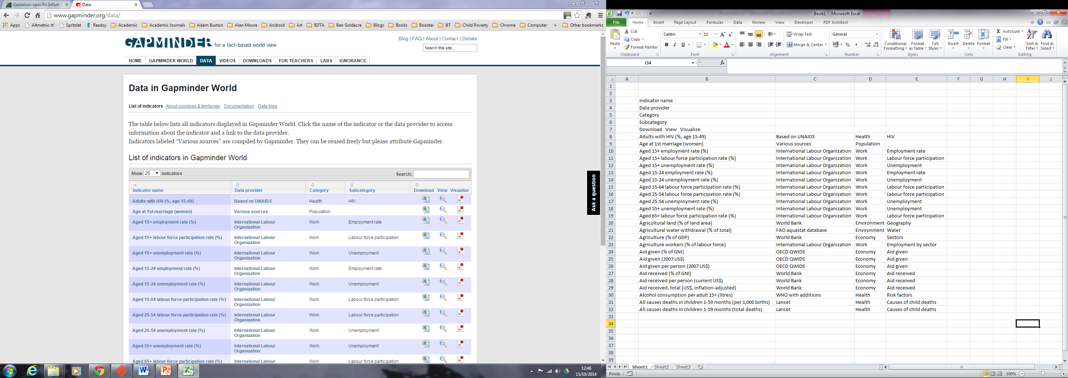
Getting data into Excel
Sometimes, copying web tables, and pasting as text works:

